Slide 1

Recruit shield
RecruitShield An Explainable Recruitment Scam Detection & Trust Verification System
Detect • Verify • Explain • Protect
Team Name : Recruit shield
OMNIKON –National Hackthon
RecruitShield helps job seekers identify suspicious recruitment messages and verify recruiter credibility using explainable risk analysis, identity verification, cross-platform detection, and a tamper-evident scam registry.

Slide 2
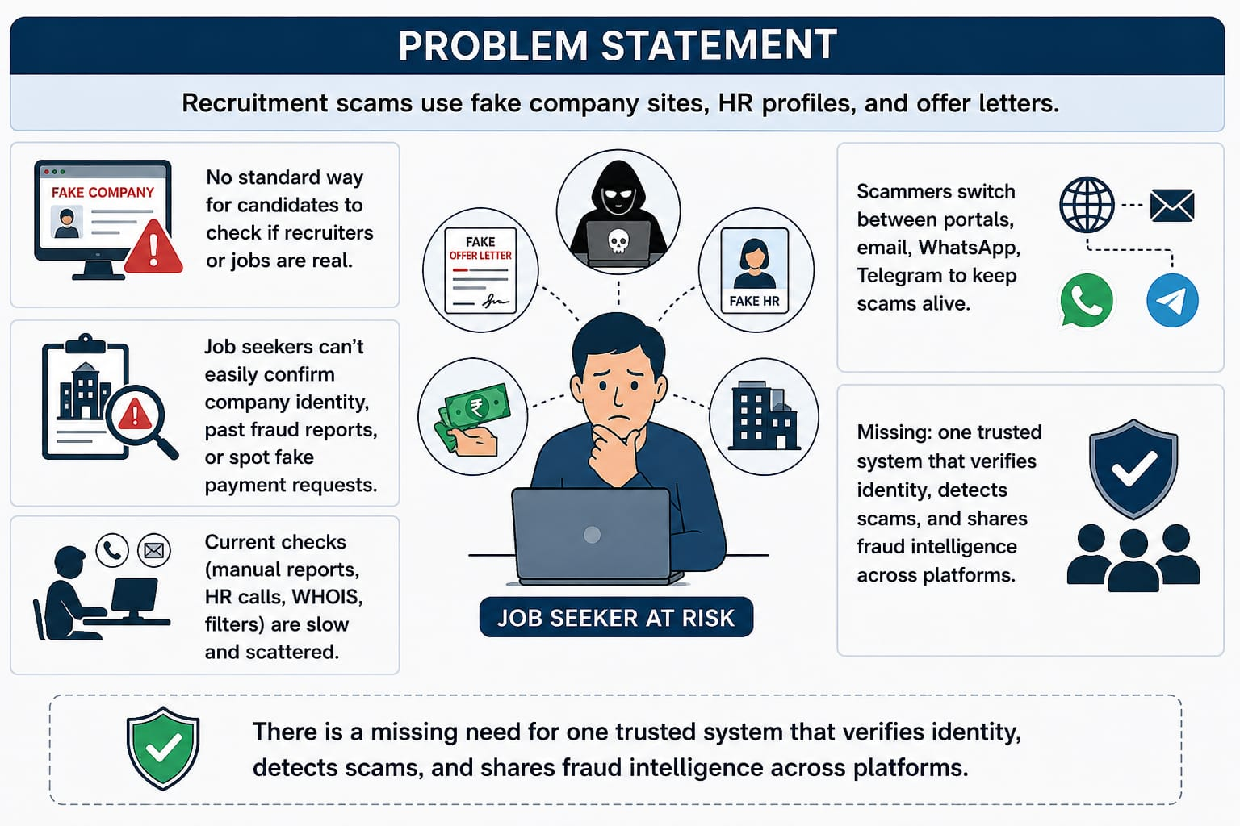
Recruit shield
Problem Statement
Recruitment scams use fake company sites, HR profiles, and offer letters.
No standard way for candidates to check if recruiters or jobs are real.
Job seekers can’t easily confirm company identity, past fraud reports, or spot fake payment requests.
Current checks (manual reports, HR calls, WHOIS, filters) are slow and scattered.
Scammers switch between portals, email, WhatsApp, Telegram to keep scams alive.
Missing: one trusted system that
verifies identity, detects scams,
and shares fraud intelligence
across platforms

Slide 3
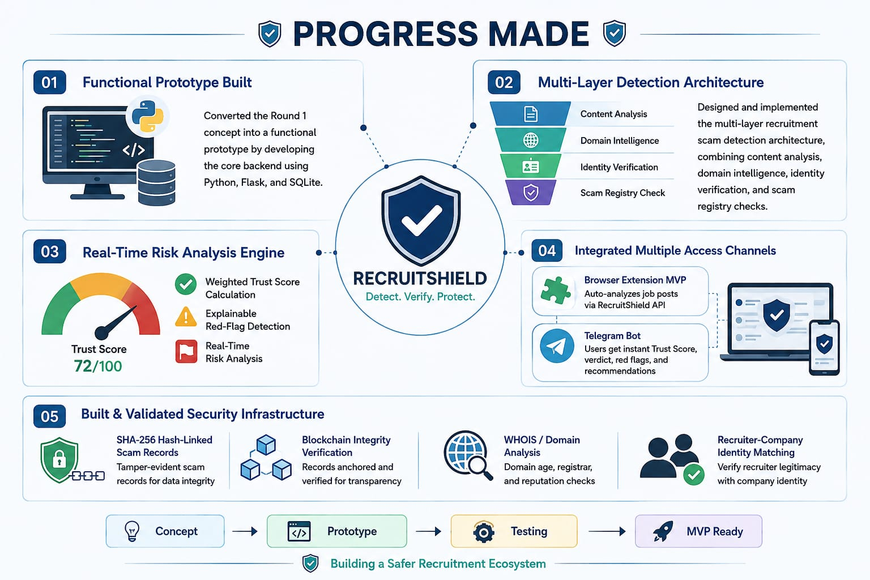
Recruit shield
Progress Made
Converted the Round 1 concept into a functional prototype by developing the core backend using Python, Flask, and SQLite.
Designed and implemented the multi-layer recruitment scam detection architecture, combining content analysis, domain intelligence, identity verification, and scam registry checks.
Developed and tested the real-time risk analysis engine, including weighted Trust Score calculation and explainable red-flag detection.
Integrated multiple access channels, successfully connecting the detection system with a browser extension MVP and a working Telegram bot.
Built and validated the supporting security infrastructure, including SHA-256 hash-linked scam records, blockchain integrity verification, WHOIS/domain analysis, and recruiter-company identity matching.
From Concept to a Working Prototype Detecting Scams with Real-Time Intelligence
Building a Safer and Trusted Recruitment Ecosystem

Slide 4
Features implemented
Recruit shield
Real‑Time Trust Score ✅
Built an engine that scores job posts/messages (0–100) and shows clear
verdicts: 🟢 Low, 🟡 Medium, 🔴 High risk.
PROGRESS MADE
Explainable Red‑Flags ✅
Highlights why it’s risky — fees, urgent payments, suspicious phrases, free email domains, new domains.
Scam Registry Prototype ✅ SHA‑256 hashed scam reports with tamper‑evident records, foundation for blockchain anchoring.
Browser Extension MVP ✅ Prototype extension that auto‑analyzes job posts via RecruitShield API, reducing manual effort.
Telegram Bot Integration ✅ Users forward suspicious messages → instant Trust Score, verdict, red flags, and recommendations.
Identity Verification ✅ Checks recruiter/company via domain match, free‑email detection, WHOIS domain age, and website validation.
“Verify.Detect.Trust – Before You Apply”.
“your Shield Against Recruitment Scams”

Slide 5
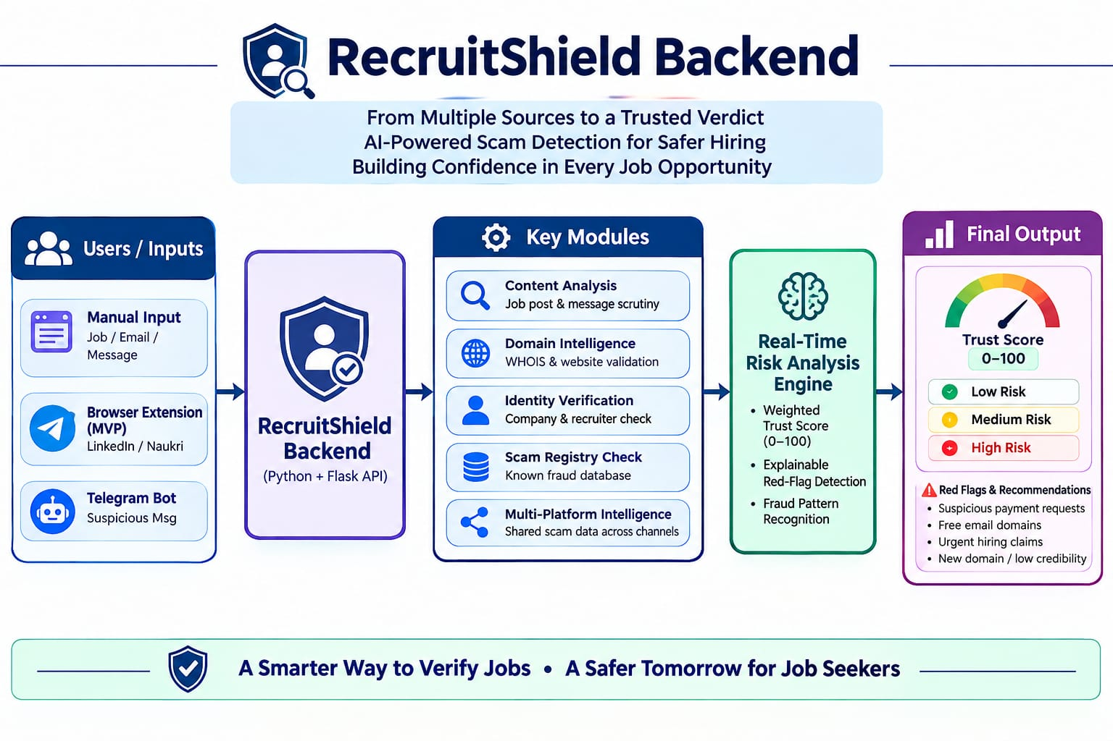
Technical Architecture
Recruit shield

Slide 6
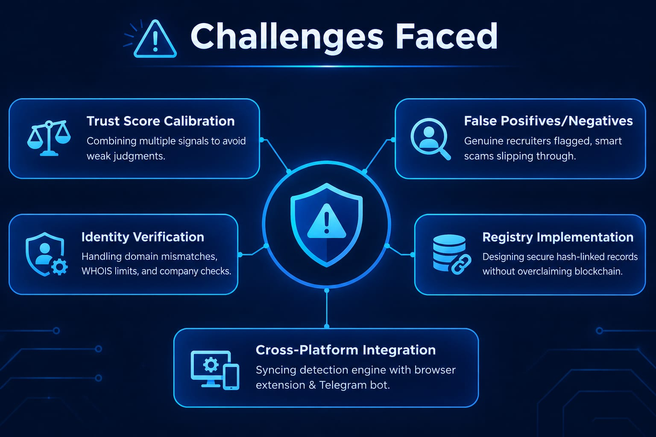
Recruit shield
Challenges Faced
Trust Score Calibration – Combining multiple signals to avoid weak judgments.
False Positives/Negatives – Genuine recruiters flagged, smart scams slipping through.
Identity Verification – Handling domain mismatches, WHOIS limits, and company checks.
Registry Implementation – Designing secure hash‑linked records without overclaiming blockchain.
Cross‑Platform Integration – Syncing detection engine with browser extension & Telegram bot.
“Turning Complex Challenges into
Trusted Solutions.”

Slide 7
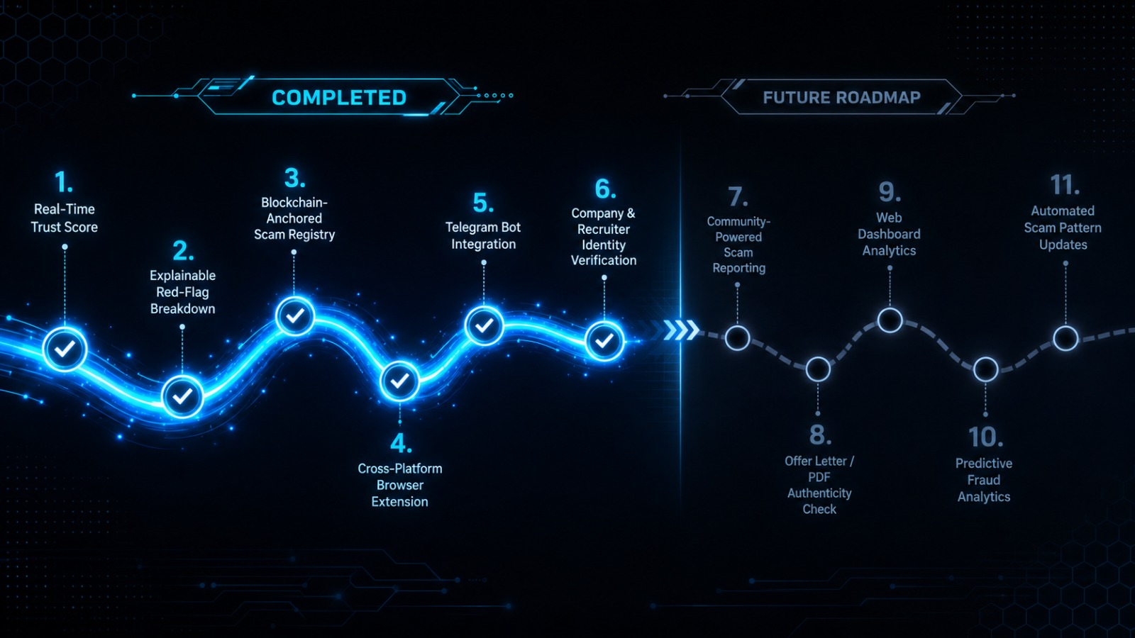
Future Roadmap
.Recruit shield

